Slide 1
Fill the Gaps in Lung Cancer
Founder: Thomas Howard
Inspired by: Sheila’s ongoing fight and survival
Location: Rancho Mirage, CA
Email: Thomas@fillthegapsinlungcancer.com
Website: www.fillthegapsinlungcancer.com
No one should fall through the cracks

Slide 2

Solutions
Early Detection
Genetic Testing
Clinical Trials

Slide 3


The Gaps That Cost Lives
Delayed Diagnosis
Sheila experienced a persistent cough that was misdiagnosed for over a year. A delayed chest X-ray eventually uncovered a tumor that had been silently developing for 15–20 years. “If annual chest X-rays were routine, she might be cancer-free today.”
Incomplete Genetic Testing
Early blood tests did not detect any gene mutations. It was only after multiple assessments—including tissue analysis and advanced laboratory methods—that the NRG1 gene mutation was identified. Six years later, a biopsy enabled further testing, revealing another mutation: HER2 gene. This discovery allowed her to receive the FDA-approved medication Hernexeos.
Unequal Access to Clinical Trials
Sheila benefited from access to innovative clinical trials in Southern California, a privilege not available many patients. Geographic location should never determine survival outcomes. “We aim to provide funding for travel to patients living in areas without trial access.”

Slide 4
Mission: Fill the Gaps
Fill the Gaps in Lung Cancer exists to eliminate the systemic failures that delay diagnosis, overlook genetic mutations, and deny patients access to life-saving clinical trials. Inspired by Sheila’s ongoing fight, we advocate for earlier screening, persistent biomarker testing, and travel support for underserved patients.
Early Detection
Advanced Testing
Trial Access
Patient Centered Advocate
“We’re not just raising awareness—we’re raising access.”

Slide 5
Gap 1
Early Diagnosis

Slide 6
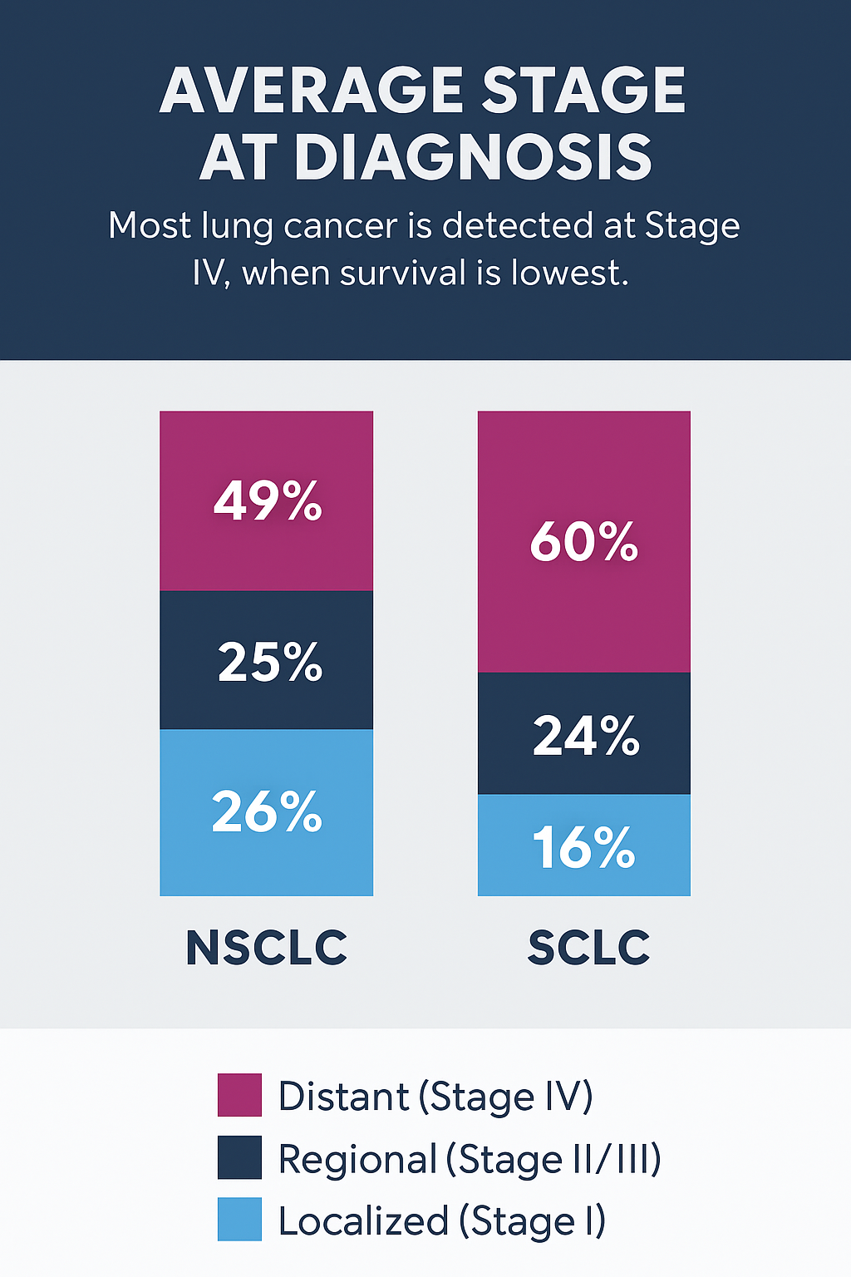
Non-Small Cell Lung Cancer (NSCLC)
Localized (Stage I): ~26% of cases
Regional (Stage II–III): ~25%
Distant (Stage IV): ~49%
Nearly half of NSCLC cases are diagnosed at Stage IV, when the cancer has already spread .
Small Cell Lung Cancer (SCLC)
Localized: ~16%
Regional: ~24%
Distant: ~60%
60% of SCLC cases are diagnosed at Stage IV, which is extremely aggressive.

Slide 7
The Case for Early Screening
The Solution
LDCT scans can detect small nodules and tumors earlier, improving outcomes
Advocating for expanded screening criteria or pilot programs in underserved populations
Pushing for research into alternative screening pathways for non-smokers or low-exposure patients
The Problem
Chest X-rays are less sensitive than LDCT for detecting early-stage lung cancer
Studies show they don’t reduce mortality in high-risk groups
It took 15–20 years before Sheila developed symptoms from her tumor — one chest X-ray during year 1–18 and Sheila could be cancer free
Nearly half of NSCLC cases are diagnosed at Stage IV, when the cancer has already spread

Slide 8
Gap 2
Genetic Testing

Slide 9
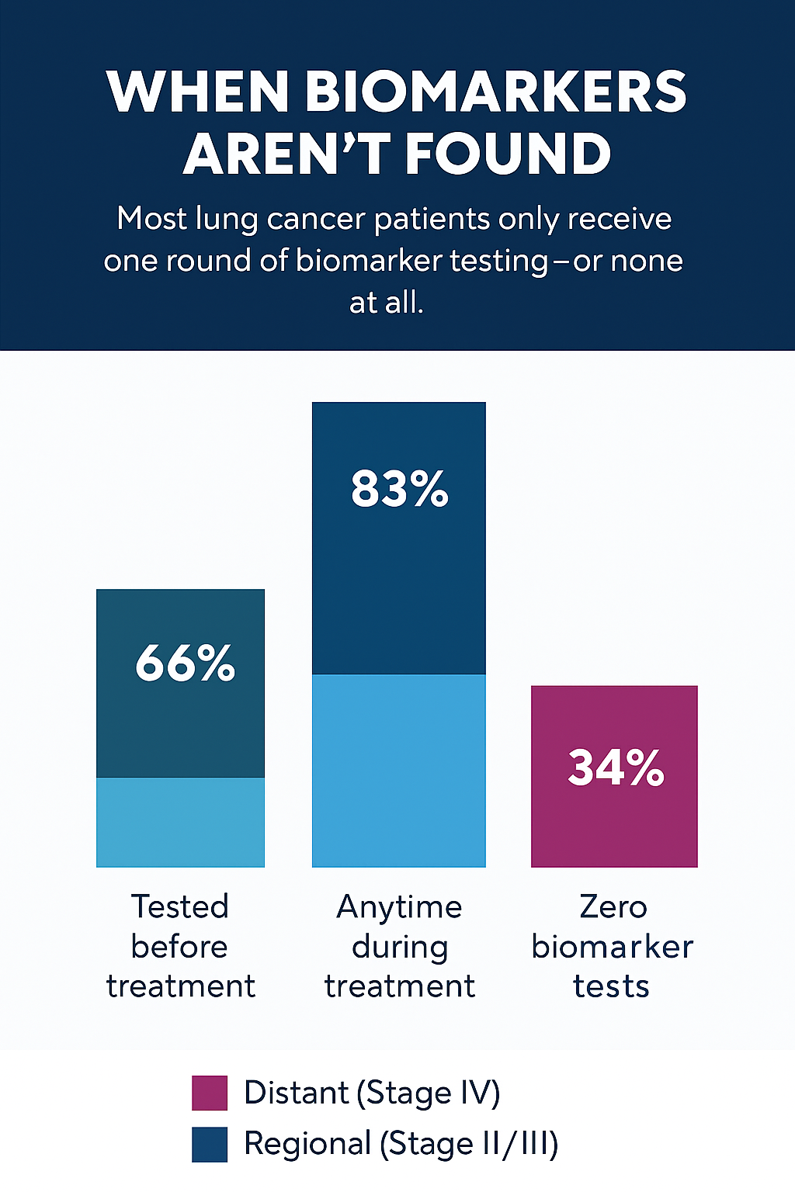
  83% of advanced NSCLC patients receive some biomarker testing during treatment
  But only 66% are tested before treatment begins
  Most patients receive a single round of testing, often limited to a few common mutations (EGFR, ALK, KRAS, etc.)
  Comprehensive testing (including RNA-based or next-gen sequencing) is not routine, especially in community settings
    Source: AACR Cancer Research Abstract 3426, 2024

Slide 10

More Testing
If initial testing is negative, repeat testing is rare unless:
  The patient is at an academic center
  The oncologist suspects a rare mutation
  The patient or caregiver pushes for it
  RNA-based testing (which found Sheila’s NRG1 mutation) is not standard and often requires special lab access or advocacy
Many actionable mutations—like NRG1, RET, MET, and NTRK—are missed in first-line testing
Patients who don’t get retested may be denied access to targeted therapies or clinical trials.

Slide 11
Gap 3
Clinical Trials

Slide 12
Only 7.1% of lung cancer patients enter clinical trials
Clinical trials are open and actively recruiting, but most patients never reach them.
Barriers like geography, awareness, eligibility confusion, and provider bias prevent participation.
Trial slots go unfilled—especially for rare mutations
Sheila got into multiple trials because she had proximity.
Sheila has participated in 5 clinical trials at three different cancer institutions
What 7.1% Really Means
Most patients don’t have that chance—even when trials are open and waiting.

Slide 13
Lung Cancer Trial Enrollment Failure Rate
80–90% of trials fail to recruit enough participants on time
55% of trials are terminated due to low enrollment
11% of trial sites fail to enroll even a single patient
40% of trials don’t meet enrollment targets and must extend timelines or add sites
Delays cost sponsors $600,000 to $8 million per day in lost development time
ASCO (American Society of Clinical Oncology) and JAMA

Slide 14
Filling the Gaps Funding
Travel
Genetic Testing
Medical Financial Assistance

Slide 15
Funding Availability
Funding is based entirely on charitable donations and is subject to availability.
Fill the Gaps in Lung Cancer actively seeks additional funding; however, future funding availability cannot be guaranteed.
Approval of application does not constitute a guarantee of funding for the entire duration of the clinical trial participation.

Slide 16

Financial Need Statement
FTG provides travel assistance to patients who demonstrate financial need. By signing this Agreement, the Patient affirms the following:
☐ I am currently enrolled in or have been accepted to a lung cancer clinical trial.
☐ I do not have sufficient personal or insurance-provided resources to cover travel costs associated with my clinical trial participation.
☐ I have not received travel funding from another organization for the same trips covered by this Agreement. If I do receive other travel funding, I will notify FTG immediately.
☐ The information I have provided in this Agreement is true and accurate to the best of my knowledge

